Slide 1
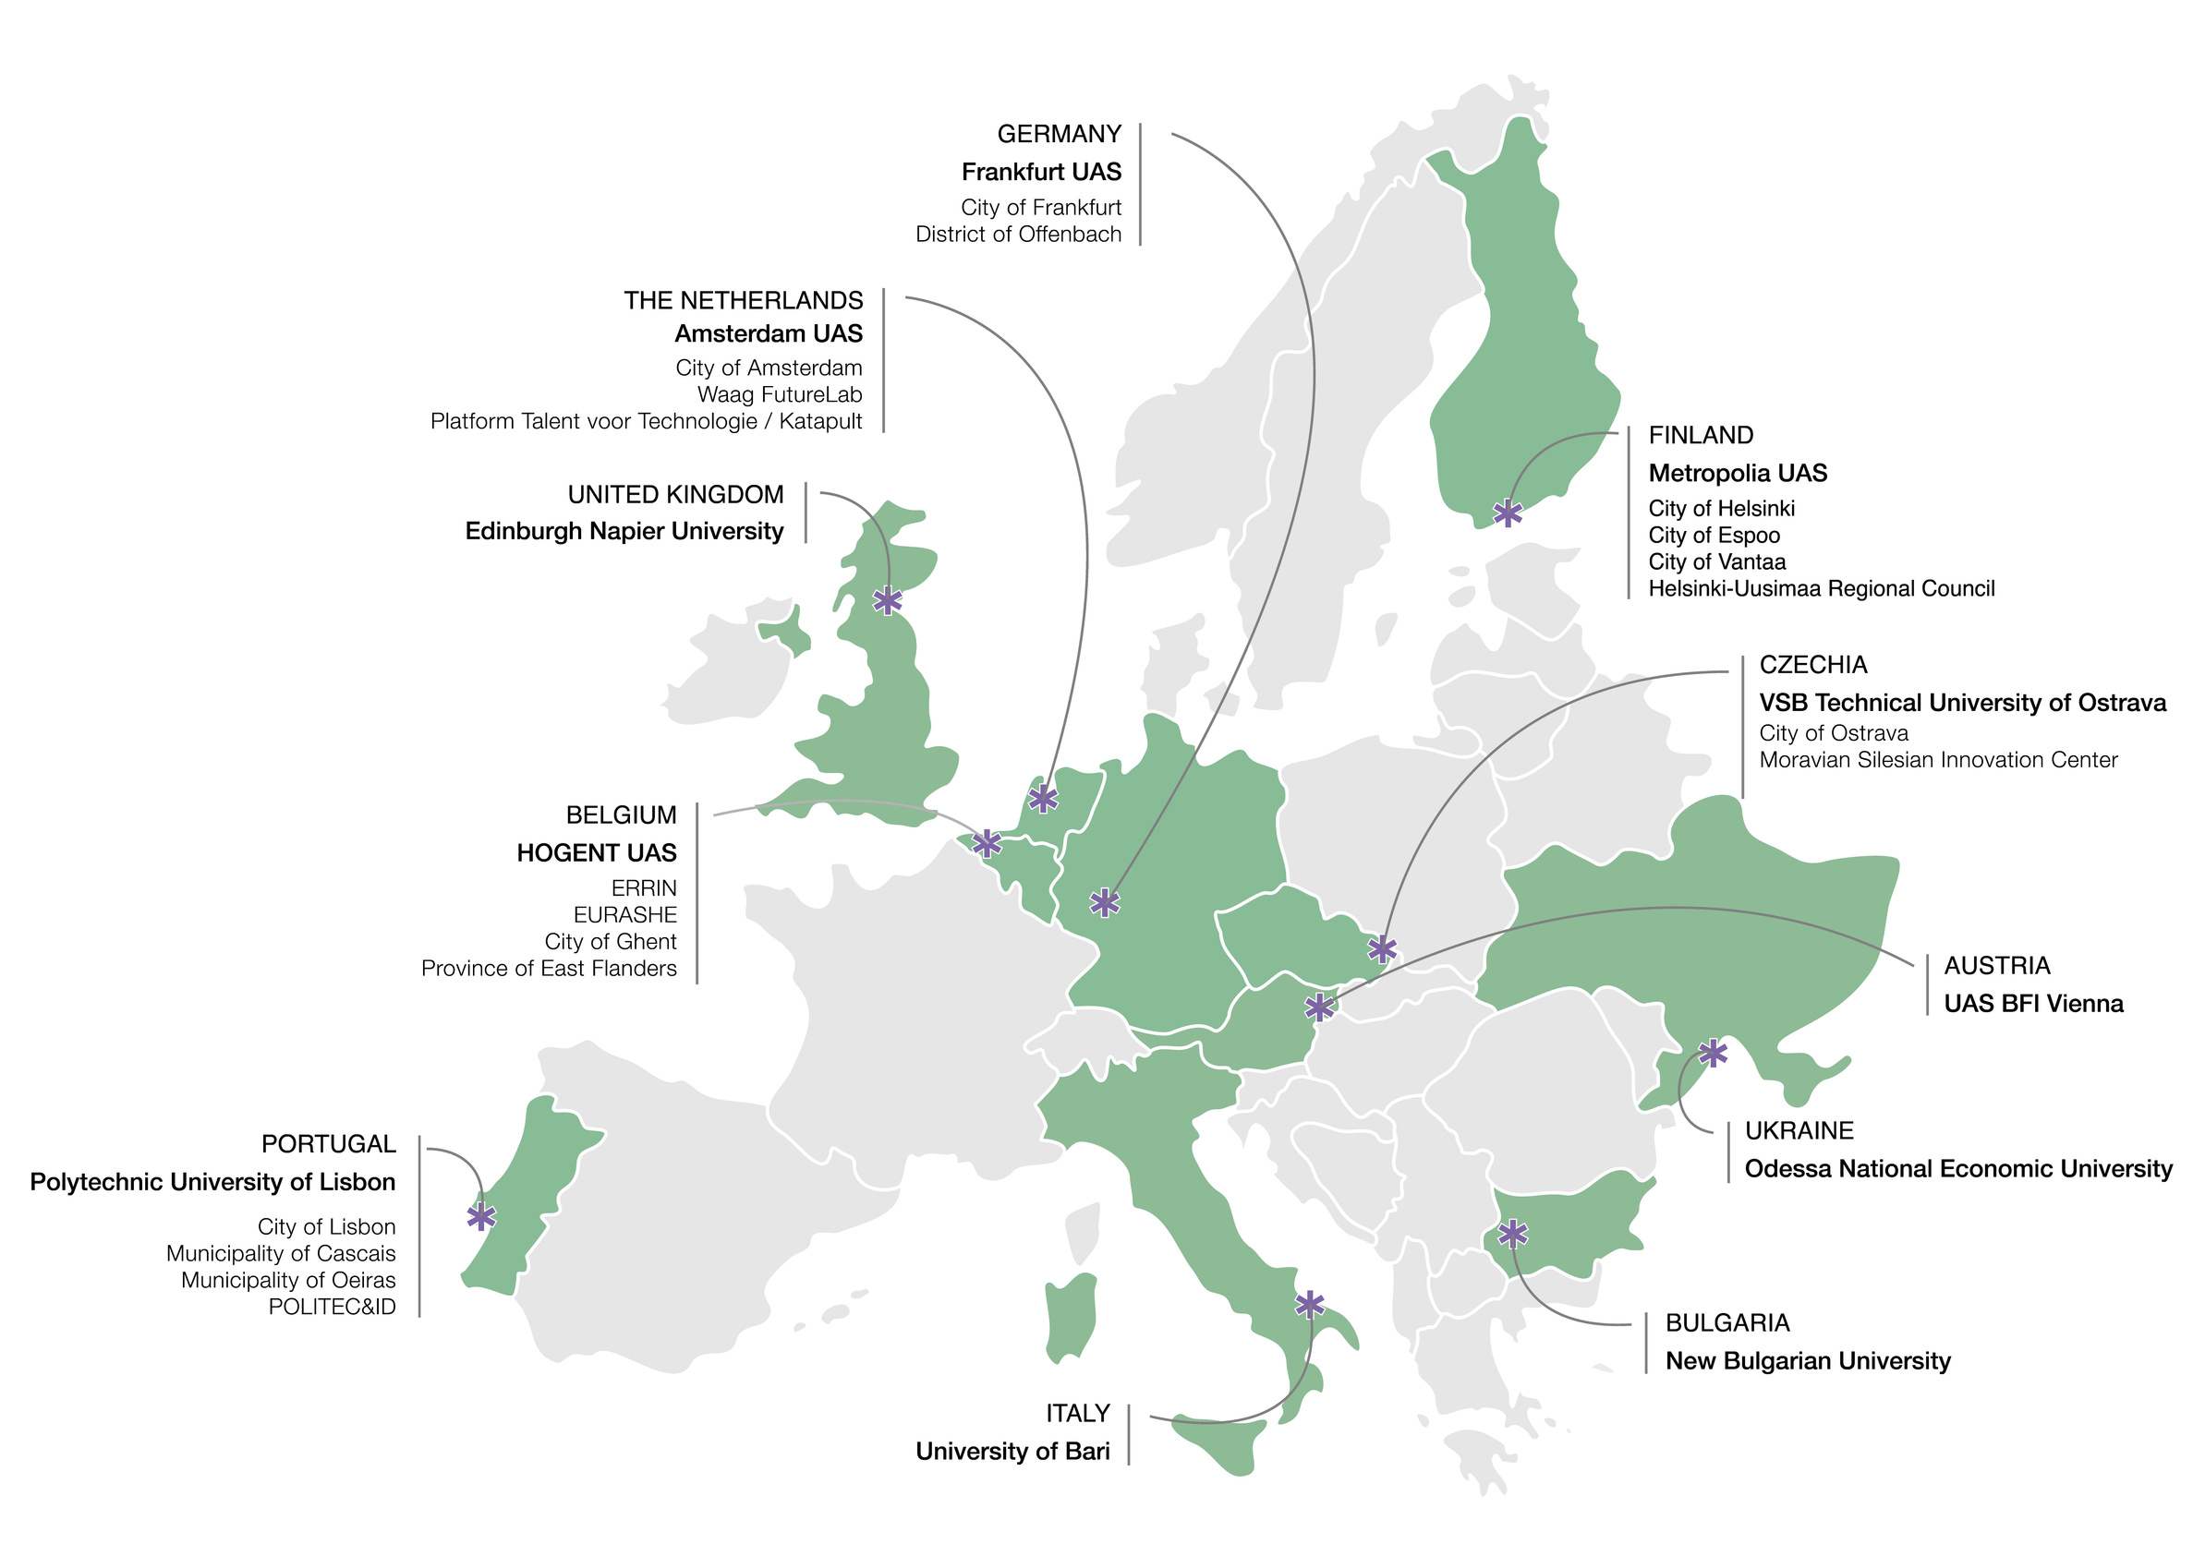




U!REKA CHANGE AGENTS 2026
Challenge:
Inclusive Climate Action
How You Will Grow?
Online workshops -April to May
Design thinking
Real world challenges
International experience and
friends
Helsinki event week:
May 4th to May 8th, 2026

Slide 2
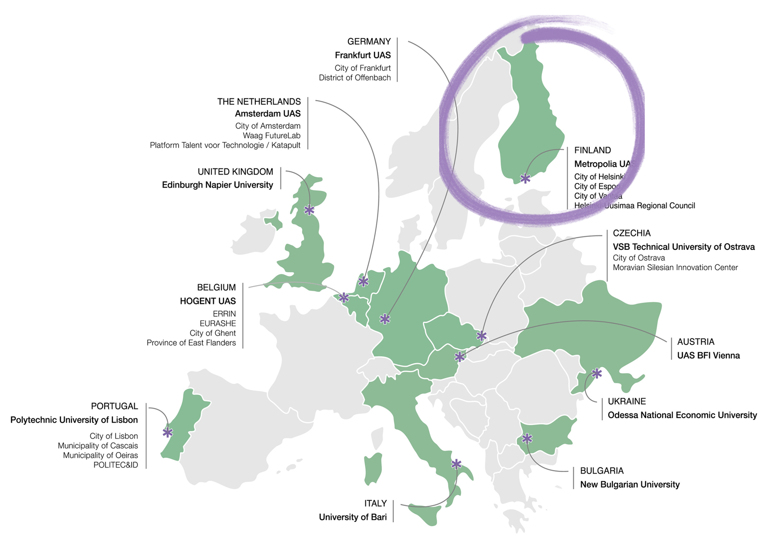

U!REKA CHANGE AGENTS 2026
Challenge:
Inclusive Climate Action
Online workshops 14:00-16:00 EEST
April 7th, April 13th, April 20th and May 18th
Event week in Helsinki:
May 4th to May 8th, 2026

Slide 3
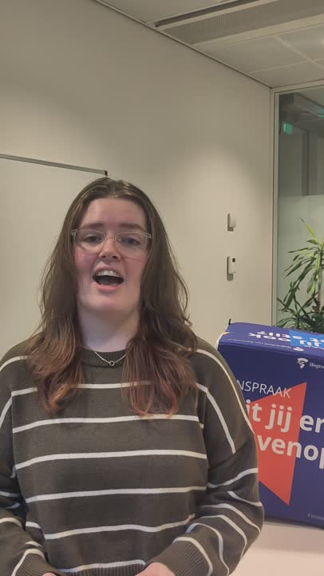



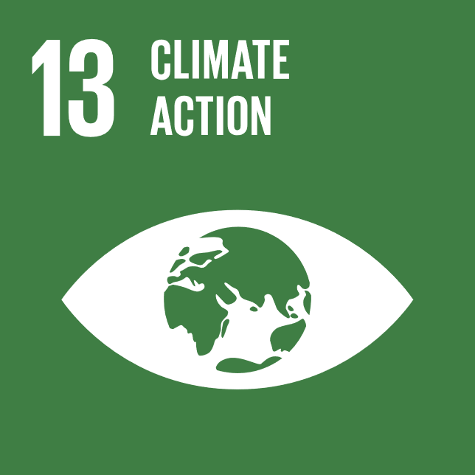
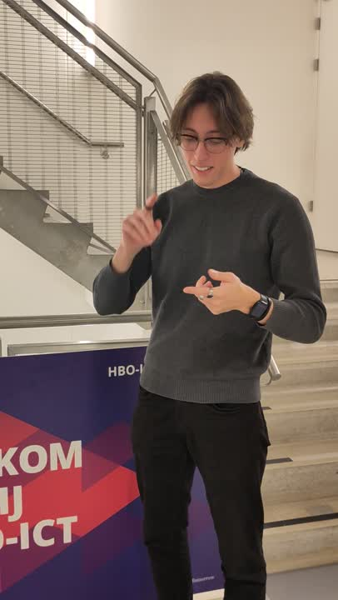
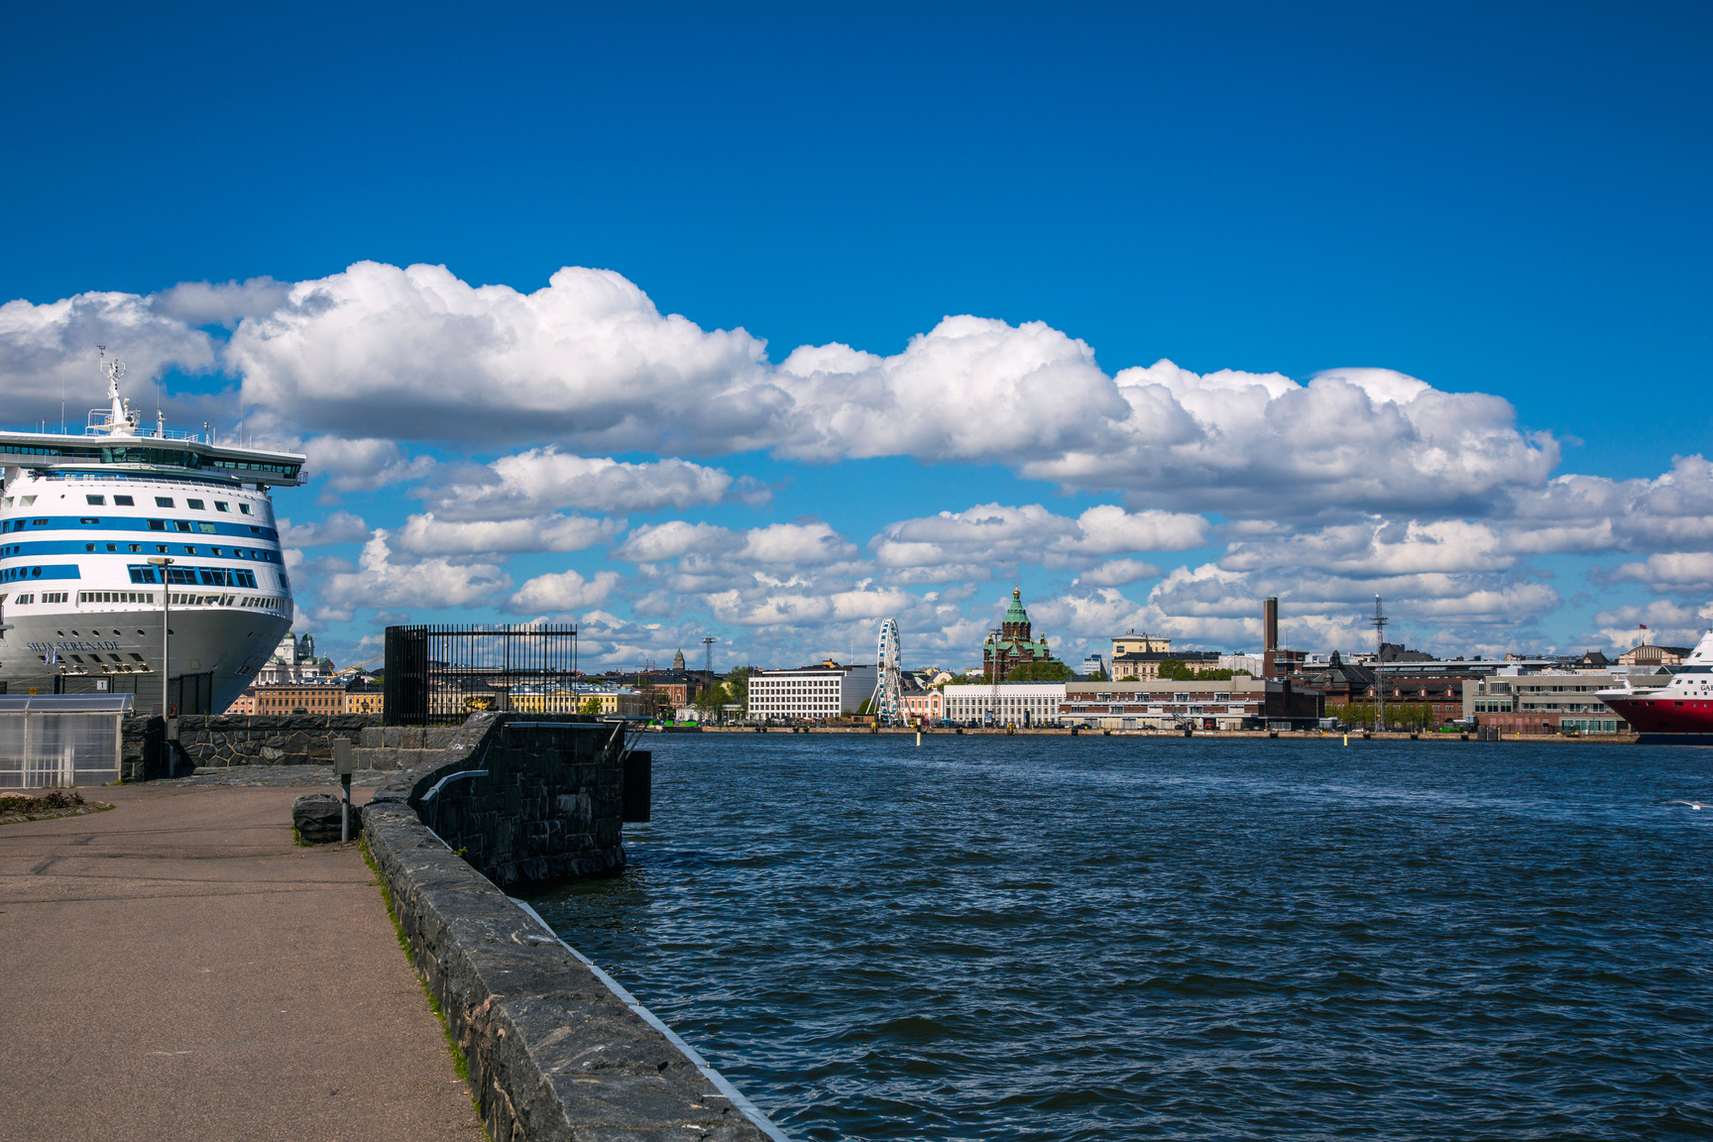
U!REKA Change Agents 2025:
Student Voices:
7 Universities
4 online workshops
1 week in Helsinki
Sustainable solutions
Hightlights:
“Working in international teams”
“Networking with other students.”
“Our group presentation was a remarkable accomplishment that we achieved together as a team.”
”Flawless quality of tap water 😃“
Most valuable outcomes:
“I improved my skills in teamwork and creative problem-solving with a focus on sustainable impact.”
“I gained different perspectives, did not think that the topic was as broad as it is before the Helsinki week”

Slide 4

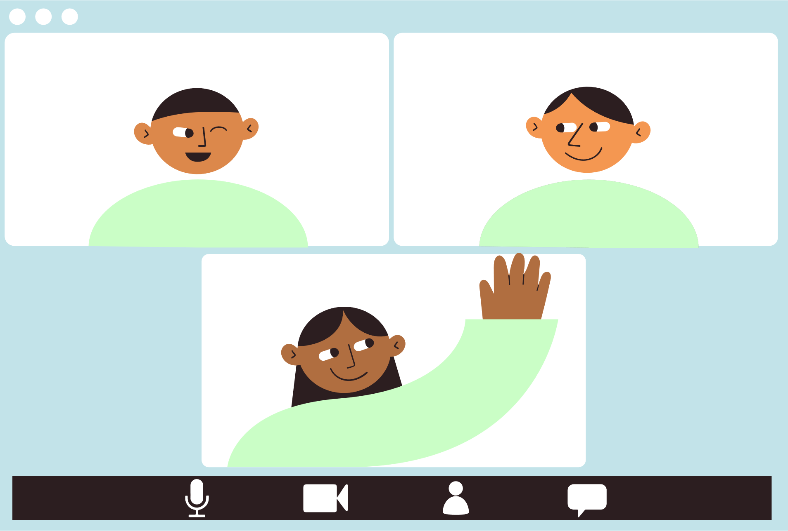
U!REKA CHANGE AGENTS
2026 Challenge:
Inclusive Climate Action
Ensuring No One is Left Behind in the Transition to Climate-Neutral Cities
9 Universities
4 online workshops:
  Teaming up
  Expert lectures
Event week in Helsinki
May 4th to May 8th, 2026
Sustainable solutions
5 ECTS

